Slide 1
Banking System Application
Python code Implementation
Yagna Ameta
16th Jan 2024

Slide 2
Objectives and Key Features
The primary goal of our application is to provide a robust and user-friendly platform for banking operations.
We focus on key functionalities, including user registration, account management, and secure transaction processing.
User Authentication: Secure login and registration mechanisms.
Account Management: Creation, balance checking, and transaction history.
Transactions: Deposit, withdrawal, and fund transfers.
Database Integration: Utilizing MySQL for persistent data storage.

Slide 3
Technologies Used
Python programming language– For logic implementation
MySQL database - For storing the data and retrieving them.
bcrypt for password hashing

Slide 4
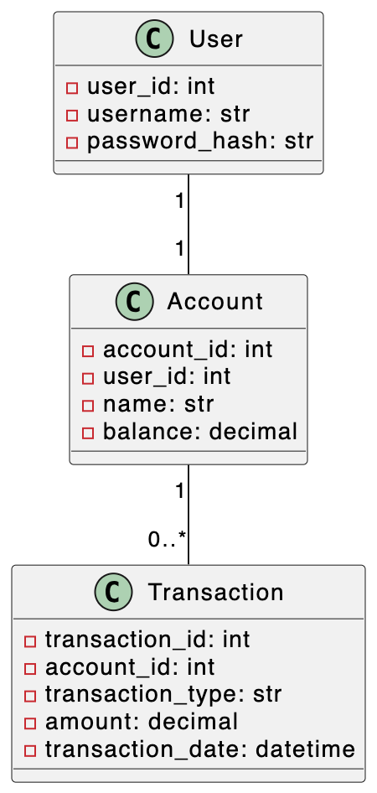
Class Diagram Overview

Slide 5
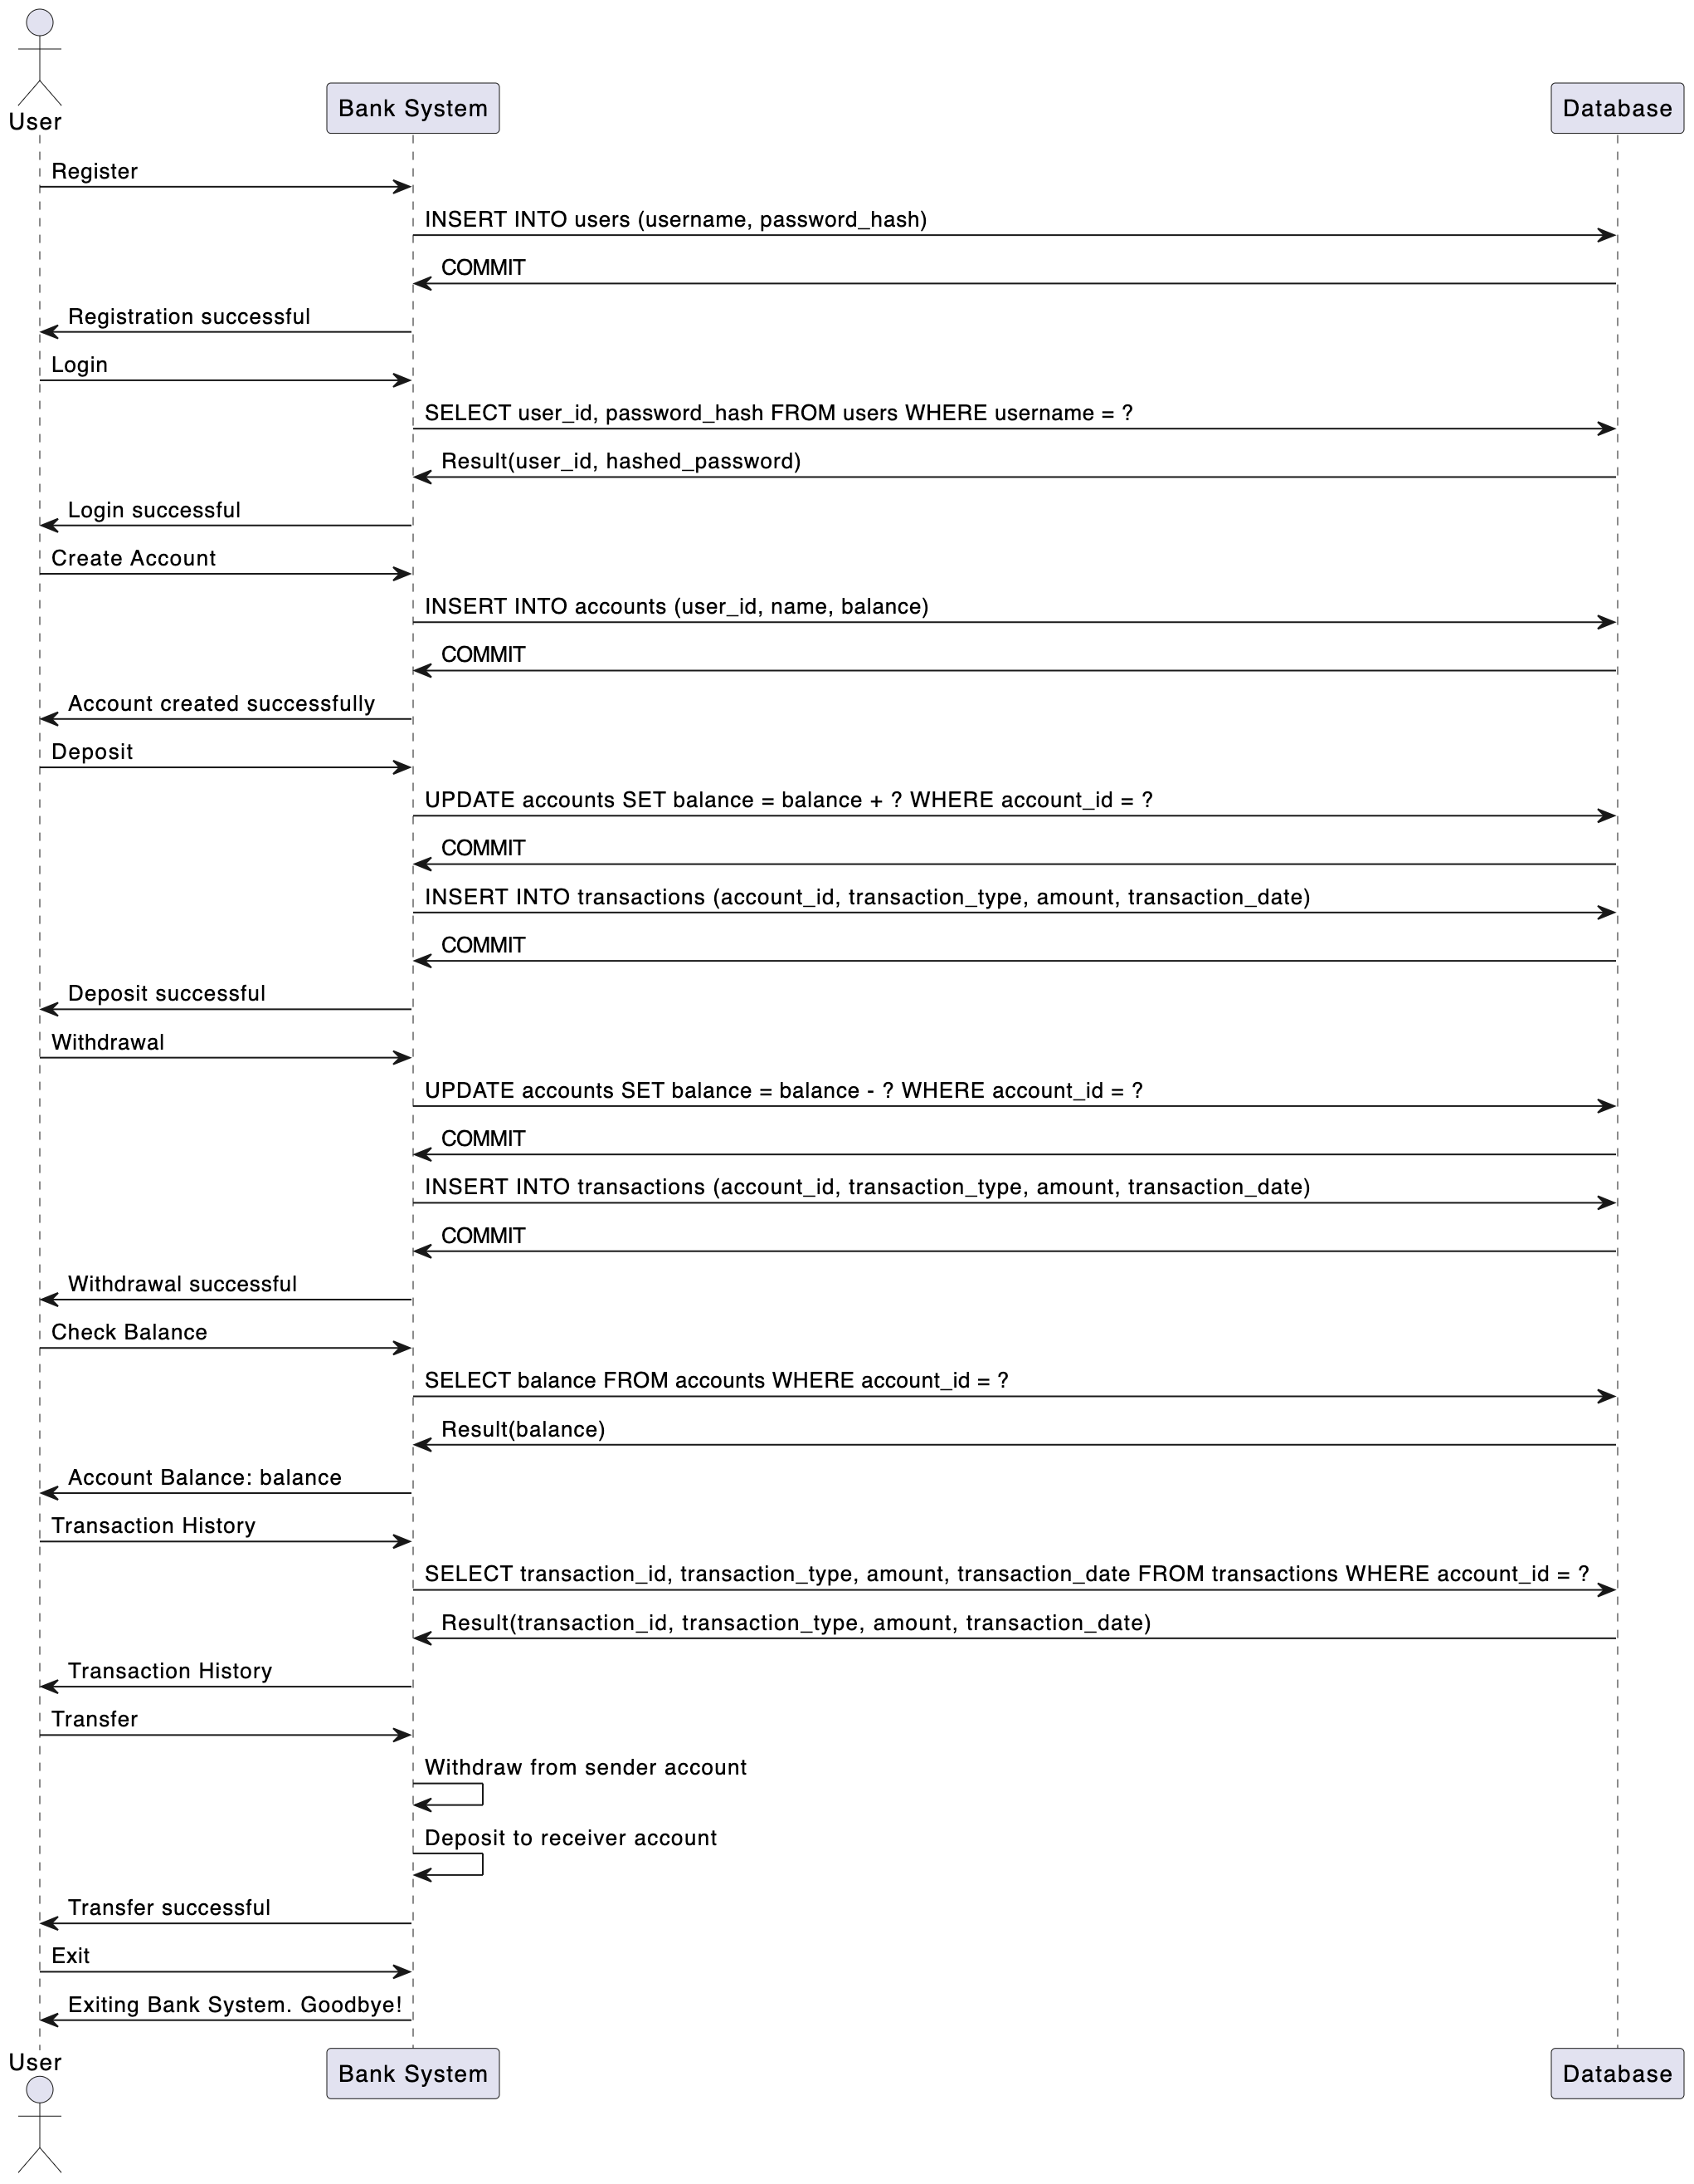
Sequence Diagram Overview

Slide 6
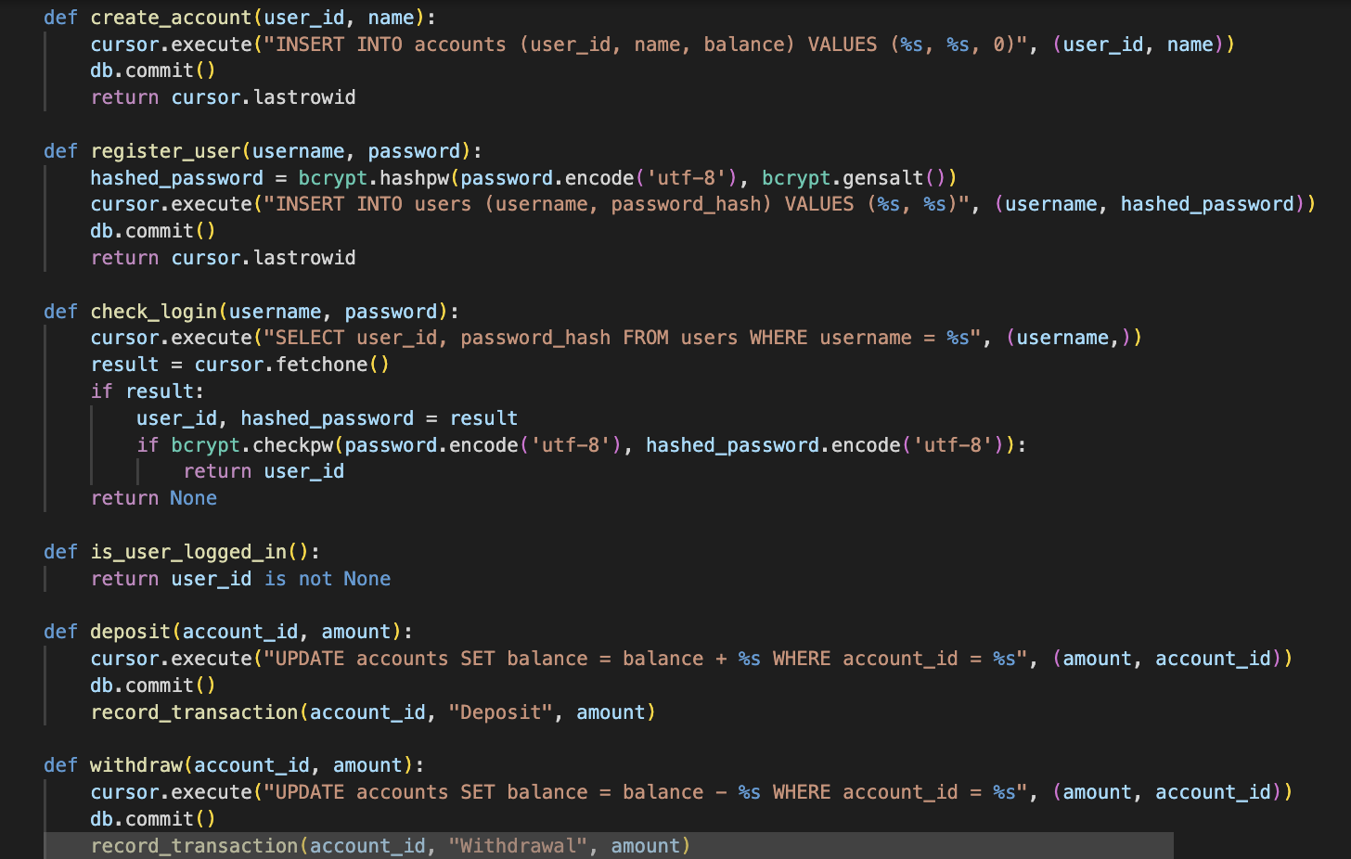
Code Structure

Slide 7
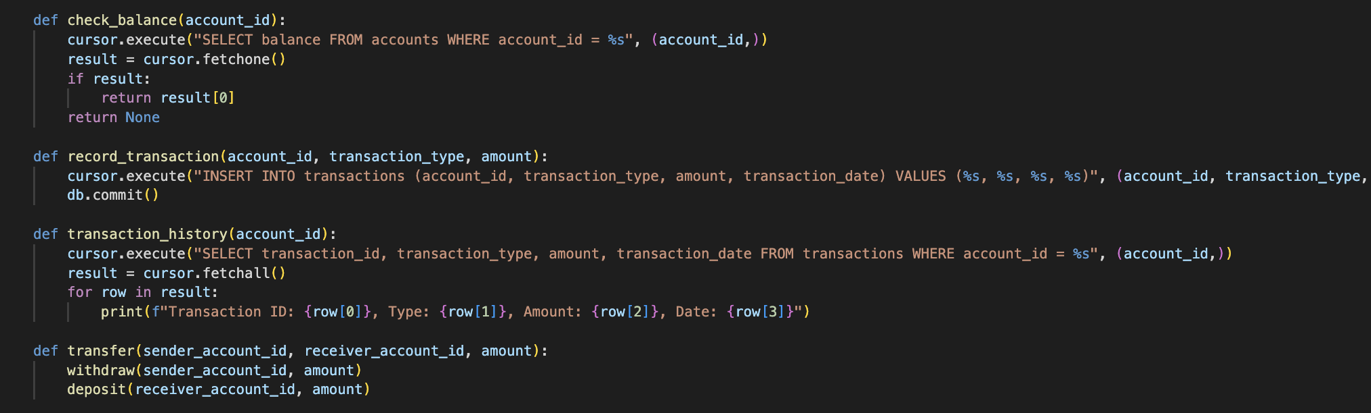

Slide 8
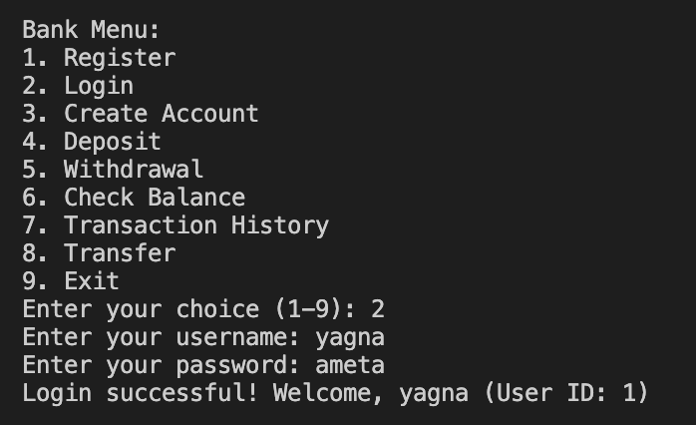
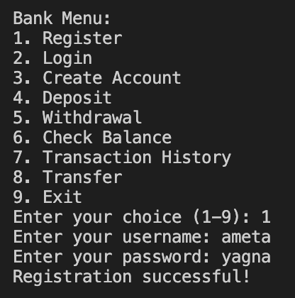
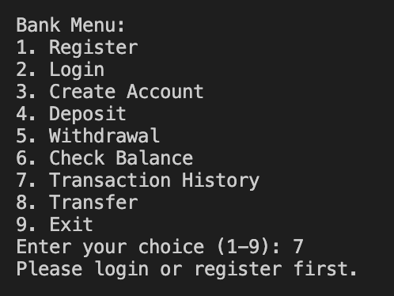
User Registration and Login

Slide 9
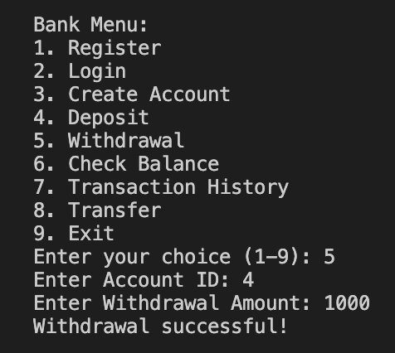
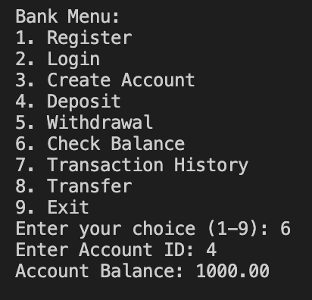
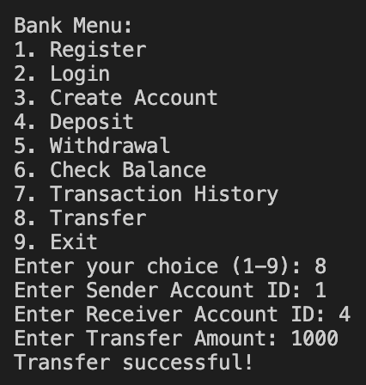
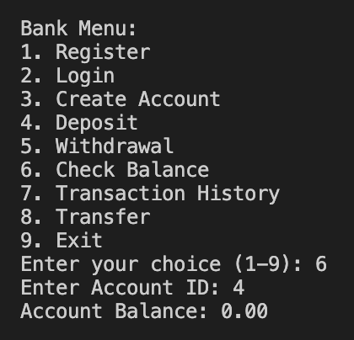
Transactions

Slide 10
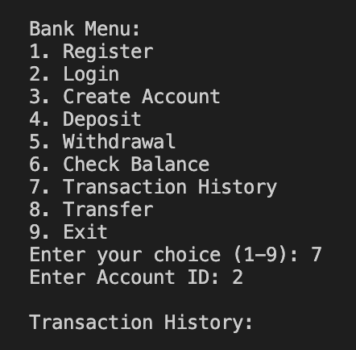
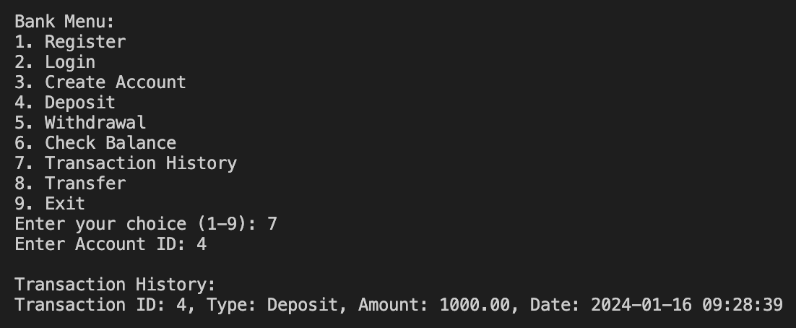
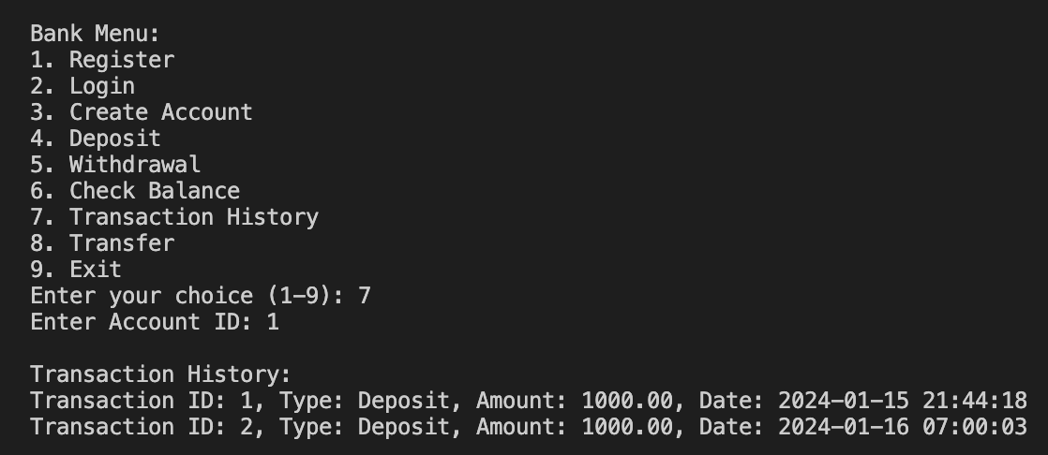
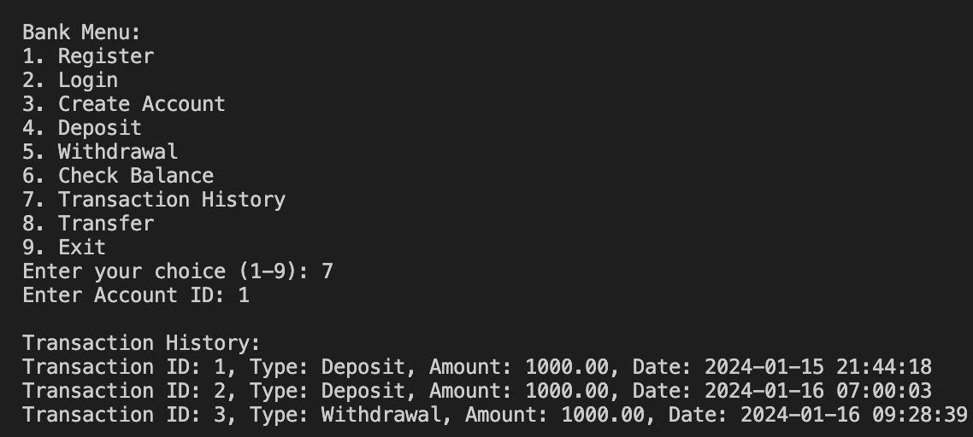
Transaction History

Slide 11
Demonstration

